Slide 1
Product Knowledge Training Session PIBAS Products - Module: Interbranch Transactions
Presented By PIBAS Support Team

Slide 2
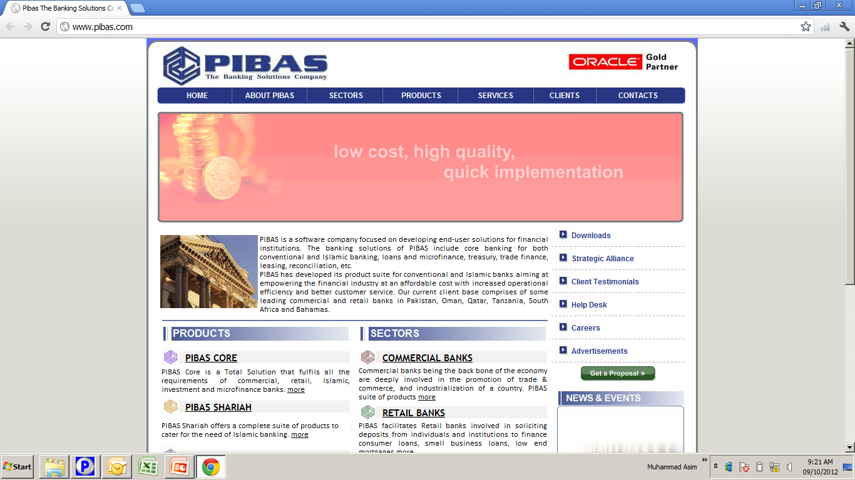
Contents
Inter Branch App. / Online Trans.
Inter Branch Transactions / Online Transactions
Online Funds Transfer
Online Cash Deposit
Online Cash Withdrawal
Online Transfer Delivery
Inter Branch Supervision
Branch Limits
User Limits
Online Transactions List

Slide 3
Inter Branch Transactions / Online Transactions
Inter Branch App. / Online Trans.
What are Online Transactions?
Any financial / non-financial transactions that are executed between different units of an organization can be considered as “Online Transactions / Inter Branch Transactions”. This is very important / useful facility for customer who can transact any where at any branch. Whether it is Online Cash Deposit or Online Cash Withdrawal or Online Funds Transfer or Online Transfer Delivery, customer can be entertained very promptly.
With respect to Internal Controls / Reconciliation, this module also reconciles transactions on the spot and no manual reconciliation process is needed.

Slide 4
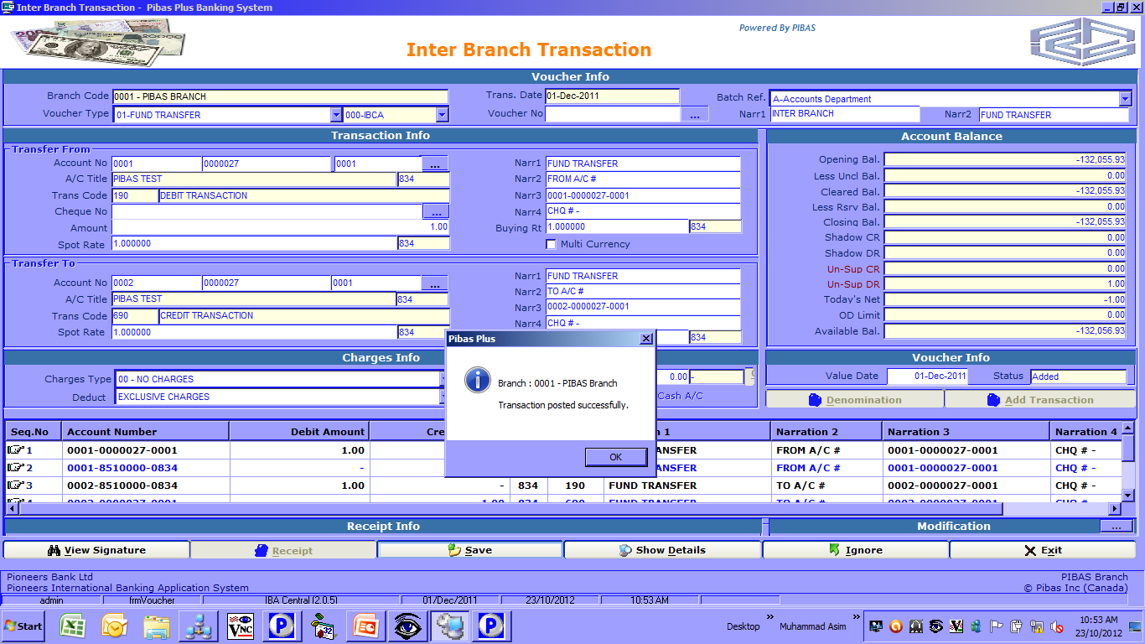
Online Funds Transfer
Inter Branch App. / Online Trans.
How To Process
Through this facility one account at originating branch is debited and another account of responding branch is credited.

Slide 5
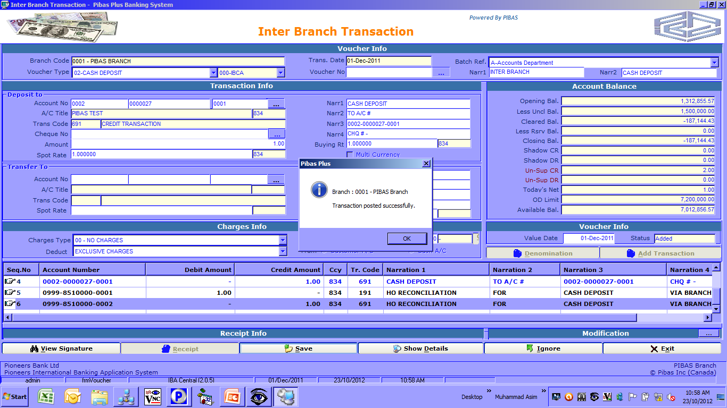
Online Cash Deposit
Inter Branch App. / Online Trans.
How To Process
Through this facility one account at responding branch is credited against a deposit received at originating branch counters.

Slide 6
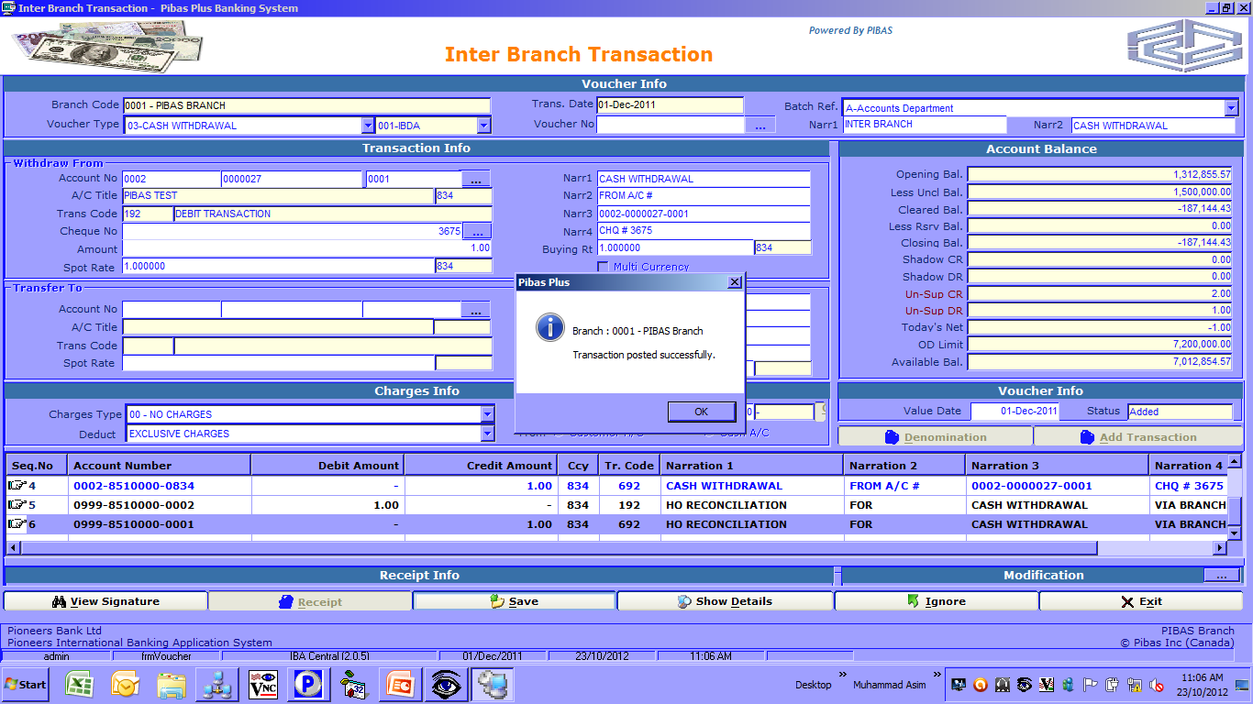
Online Cash Withdrawal
Inter Branch App. / Online Trans.
How To Process
Through this facility one account at responding branch is debited with cheque number against a payment made to client at originating branch counters.

Slide 7
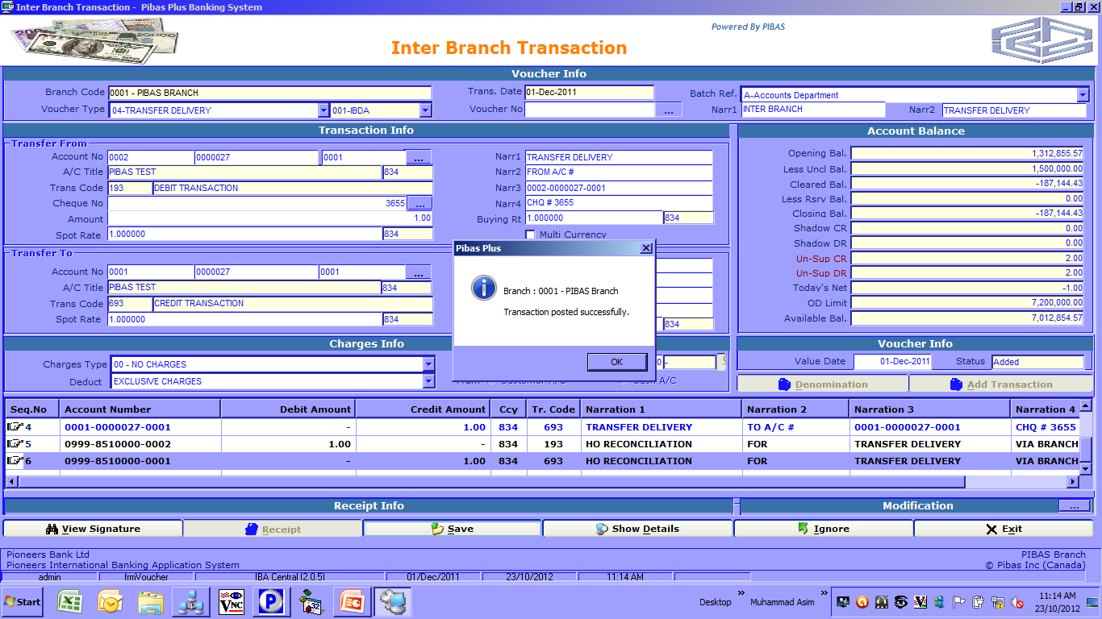
Online Transfer Delivery
Inter Branch App. / Online Trans.
How To Process
Through this facility one account at responding branch is debited with cheque number against a credit made to another client at originating branch.

Slide 8
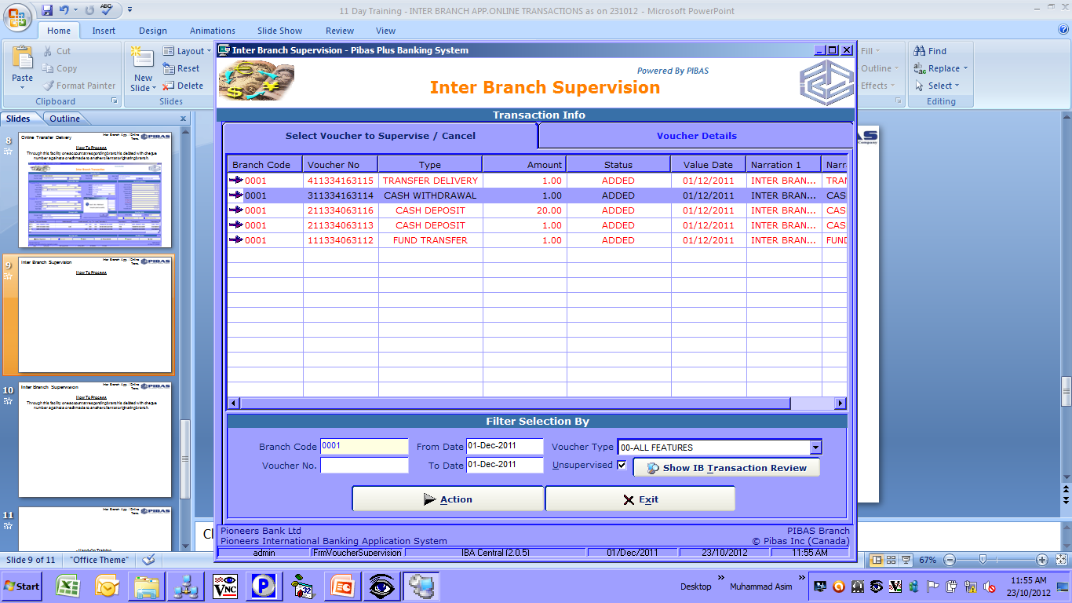
Inter Branch Supervision
Inter Branch App. / Online Trans.
How To Process

Slide 9
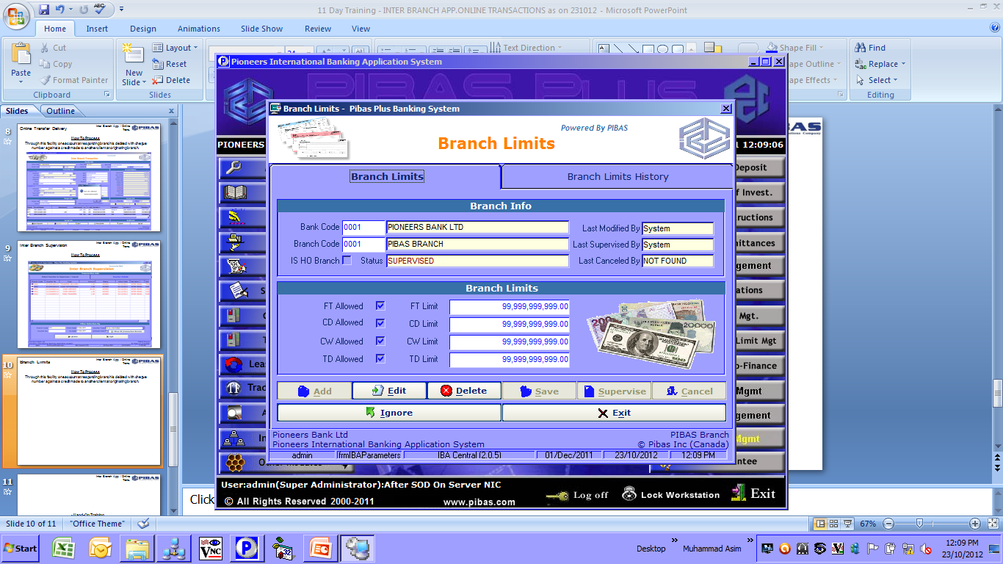
Branch Limits
Inter Branch App. / Online Trans.
How To Process
In this parameter maintenance we can define that this is an online branch can transact under the given / prescribed limits as per management.

Slide 10
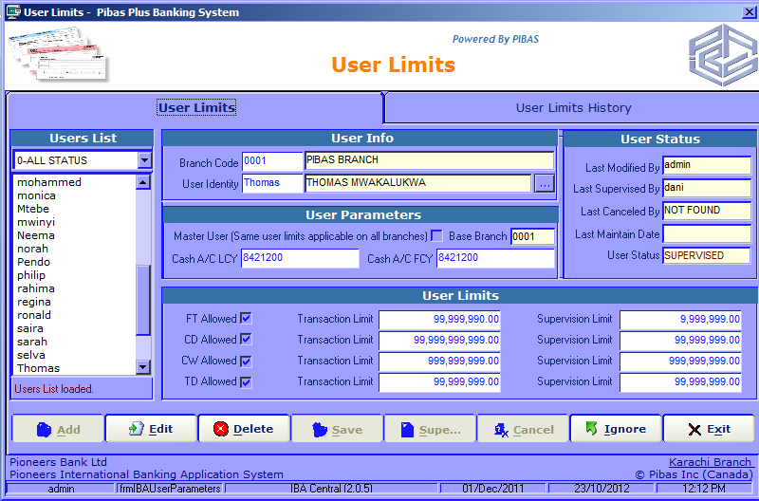
User Limits
Inter Branch App. / Online Trans.
How To Process
In this parameter maintenance, all online users limits are defined whether they are Online User or Online Authorizer / Supervisor.

Slide 11
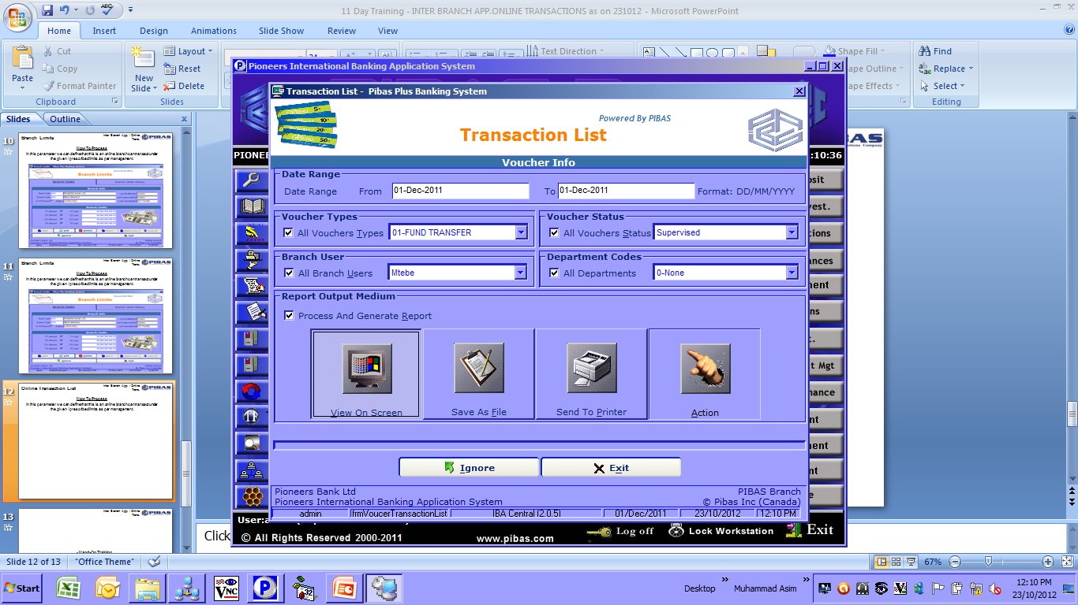
Online Transaction List
Inter Branch App. / Online Trans.
How To Process
This report provides all related data pertains to Online Transactions

Slide 12
Inter Branch App. / Online Trans.
Hand-On Training
Questions & Answers
Participants Feedback for enhancement of Training and System
Many Thanks For Your Active Participation

